Slide 1


CSB4202 - DATABASE MANAGEMENT SYSTEMS
B.Tech – III Semester
Dr. A. Antonidoss
Associate professor
School of Computing Sciences,
Department of Computer Science and Engineering

Slide 2
Chapter 1: Introduction
Purpose of Database Systems
View of Data
Data Models
Data Definition Language
Data Manipulation Language
Transaction Management
Storage Management
Database Administrator
Database Users
Overall System Structure

Slide 3
Database Management System (DBMS)
Collection of interrelated data
Set of programs to access the data
DBMS contains information about a particular enterprise
DBMS provides an environment that is both convenient and efficient to use.
Database Applications:
Banking: all transactions
Airlines: reservations, schedules
Universities: registration, grades
Sales: customers, products, purchases
Manufacturing: production, inventory, orders, supply chain
Human resources: employee records, salaries, tax deductions
Databases touch all aspects of our lives

Slide 4
Purpose of Database System
In the early days, database applications were built on top of file systems
Drawbacks of using file systems to store data:
Data redundancy and inconsistency
Multiple file formats, duplication of information in different files
Difficulty in accessing data
Need to write a new program to carry out each new task
Data isolation — multiple files and formats
Integrity problems
Integrity constraints (e.g. account balance > 0) become part of program code
Hard to add new constraints or change existing ones

Slide 5
Purpose of Database Systems (Cont.)
Drawbacks of using file systems (cont.)
Atomicity of updates
Failures may leave database in an inconsistent state with partial updates carried out
E.g. transfer of funds from one account to another should either complete or not happen at all
Concurrent access by multiple users
Concurrent accessed needed for performance
Uncontrolled concurrent accesses can lead to inconsistencies
E.g. two people reading a balance and updating it at the same time
Security problems
Database systems offer solutions to all the above problems

Slide 6
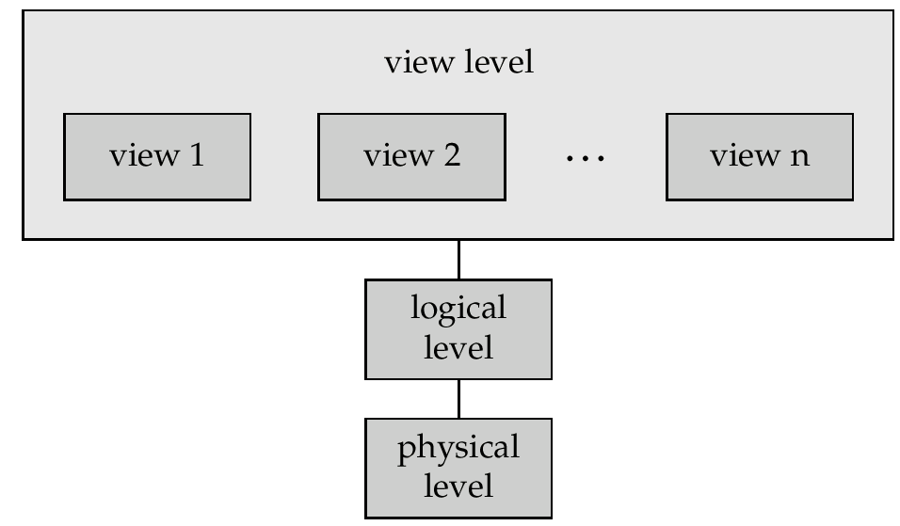
View of Data
An architecture for a database system

Slide 7
Levels of Abstraction
Physical level describes how a record (e.g., customer) is stored.
Logical level: describes data stored in database, and the relationships among the data.
type customer = record name : string; street : string; city : integer; end;
View level: application programs hide details of data types. Views can also hide information (e.g., salary) for security purposes.

Slide 8
Instances and Schemas
Similar to types and variables in programming languages
Schema – the logical structure of the database
e.g., the database consists of information about a set of customers and accounts and the relationship between them)
Analogous to type information of a variable in a program
Physical schema: database design at the physical level
Logical schema: database design at the logical level
Instance – the actual content of the database at a particular point in time
Analogous to the value of a variable
Physical Data Independence – the ability to modify the physical schema without changing the logical schema
Applications depend on the logical schema
In general, the interfaces between the various levels and components should be well defined so that changes in some parts do not seriously influence others.

Slide 9
Data Models
A collection of tools for describing
data
data relationships
data semantics
data constraints
Entity-Relationship model
Relational model
Other models:
object-oriented model
semi-structured data models
Older models: network model and hierarchical model

Slide 10
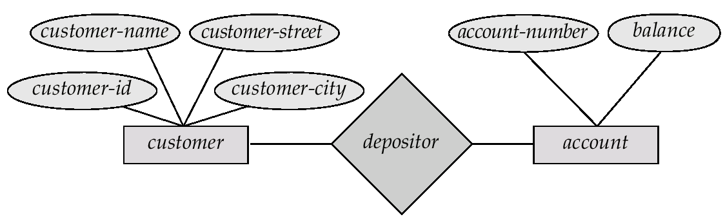
Entity-Relationship Model
Example of schema in the entity-relationship model

Slide 11
Entity Relationship Model (Cont.)
E-R model of real world
Entities (objects)
E.g. customers, accounts, bank branch
Relationships between entities
E.g. Account A-101 is held by customer Johnson
Relationship set depositor associates customers with accounts
Widely used for database design
Database design in E-R model usually converted to design in the relational model (coming up next) which is used for storage and processing

Slide 12
Relational Model
Attributes
Example of tabular data in the relational model
Customer-id
customer-
name
customer-
street
customer-
city
account-
number
192-83-7465
019-28-3746
192-83-7465
321-12-3123
019-28-3746
Johnson
Smith
Johnson
Jones
Smith
Alma
North
Alma
Main
North
Palo Alto
Rye
Palo Alto
Harrison
Rye
A-101
A-215
A-201
A-217
A-201

Slide 13
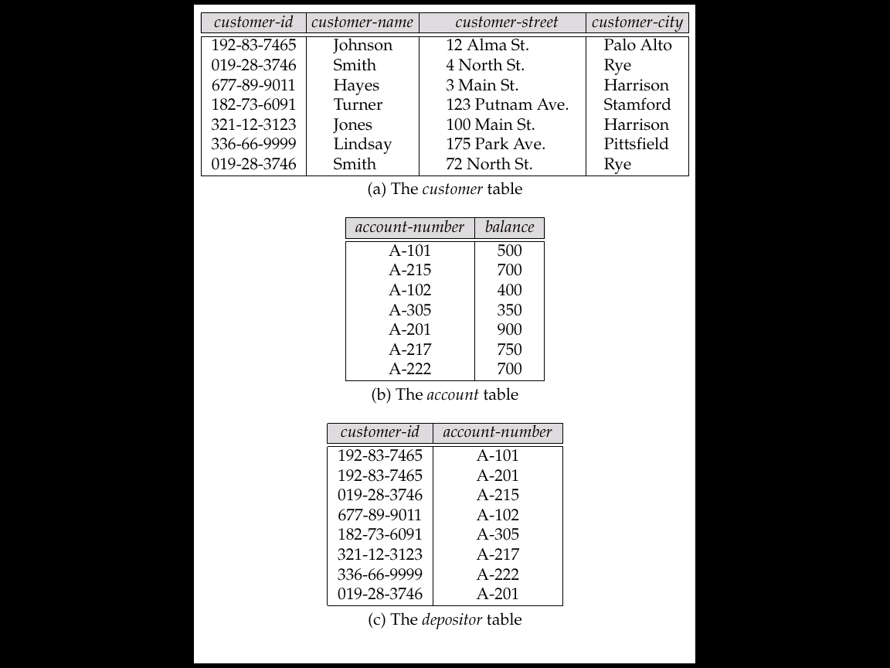
A Sample Relational Database

Slide 14
Data Definition Language (DDL)
Specification notation for defining the database schema
E.g. create table account ( account-number char(10), balance integer)
DDL compiler generates a set of tables stored in a data dictionary
Data dictionary contains metadata (i.e., data about data)
database schema
Data storage and definition language
language in which the storage structure and access methods used by the database system are specified
Usually an extension of the data definition language

Slide 15
Data Manipulation Language (DML)
Language for accessing and manipulating the data organized by the appropriate data model
DML also known as query language
Two classes of languages
Procedural – user specifies what data is required and how to get those data
Nonprocedural – user specifies what data is required without specifying how to get those data
SQL is the most widely used query language

Slide 16
SQL
SQL: widely used non-procedural language
E.g. find the name of the customer with customer-id 192-83-7465 select customer.customer-name from customer where customer.customer-id = ‘192-83-7465’
E.g. find the balances of all accounts held by the customer with customer-id 192-83-7465 select account.balance from depositor, account where depositor.customer-id = ‘192-83-7465’ and depositor.account-number = account.account-number
Application programs generally access databases through one of
Language extensions to allow embedded SQL
Application program interface (e.g. ODBC/JDBC) which allow SQL queries to be sent to a database

Slide 17
Database Users
Users are differentiated by the way they expect to interact with the system
Application programmers – interact with system through DML calls
Sophisticated users – form requests in a database query language
Specialized users – write specialized database applications that do not fit into the traditional data processing framework
Naïve users – invoke one of the permanent application programs that have been written previously
E.g. people accessing database over the web, bank tellers, clerical staff

Slide 18
Database Administrator
Coordinates all the activities of the database system; the database administrator has a good understanding of the enterprise’s information resources and needs.
Database administrator's duties include:
Schema definition
Storage structure and access method definition
Schema and physical organization modification
Granting user authority to access the database
Specifying integrity constraints
Acting as liaison with users
Monitoring performance and responding to changes in requirements

Slide 19
Transaction Management
A transaction is a collection of operations that performs a single logical function in a database application
Transaction-management component ensures that the database remains in a consistent (correct) state despite system failures (e.g., power failures and operating system crashes) and transaction failures.
Concurrency-control manager controls the interaction among the concurrent transactions, to ensure the consistency of the database.

Slide 20
Storage Management
Storage manager is a program module that provides the interface between the low-level data stored in the database and the application programs and queries submitted to the system.
The storage manager is responsible to the following tasks:
interaction with the file manager
efficient storing, retrieving and updating of data

Slide 21
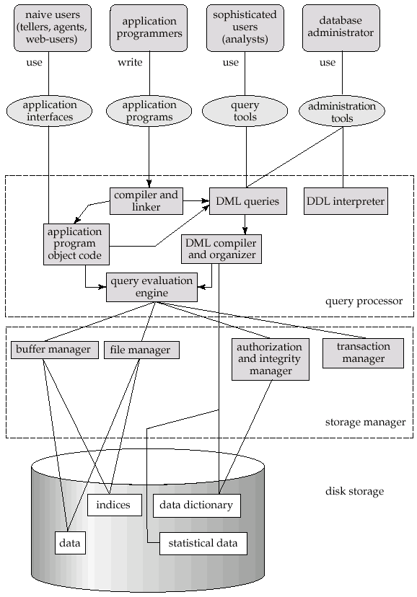
Overall System Structure

Slide 22
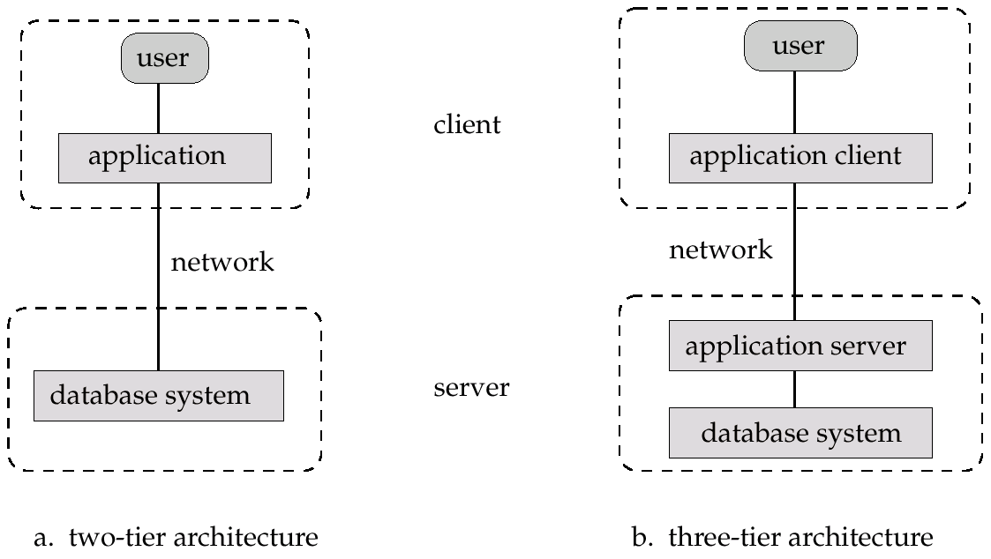
Application Architectures
Two-tier architecture: E.g. client programs using ODBC/JDBC to communicate with a database
Three-tier architecture: E.g. web-based applications, and applications built using “middleware”

Slide 23
Summary
Purpose of Database Systems
View of Data
Data Models
Data Definition Language
Data Manipulation Language
Transaction Management
Storage Management
Database Administrator
Database Users
Overall System Structure

Slide 24
Quiz
The view of total database content is
a) Conceptual view. b) Internal view.
c) External view.
d) Physical View.

Slide 25
Quiz
The view of total database content is
a) Conceptual view. b) Internal view.
c) External view.
d) Physical View.
Answer a

Slide 26


Slide 27
The End

